Slide 1
SUPERVISED LEARNING: CLASSIFICATION
Probabilistic Learning: Using Naive Bayes

Slide 2
Introduction
Naïve Bayes Classifier is one of the simple and most effective Classification algorithms which helps in building the fast machine learning models that can make quick predictions.
It is a probabilistic classifier, which means it predicts on the basis of the probability of an object.
Some popular examples of Naïve Bayes Algorithm are spam filtration, Sentimental analysis, and classifying articles.

Slide 3
When a meteorologist provides a weather forecast, precipitation is typically described with terms such as "70 percent chance of rain." Such forecasts are known as probability of precipitation reports.
The Naive Bayes algorithm describes a simple method to apply Bayes' theorem to classification problems.
The Naive Bayes algorithm is named as such because it makes some "naive“assumptions about the data.

Slide 4
In particular, Naive Bayes assumes that all of the features in the dataset are equally important and independent.
These assumptions are rarely true in most real-world applications.

Slide 5
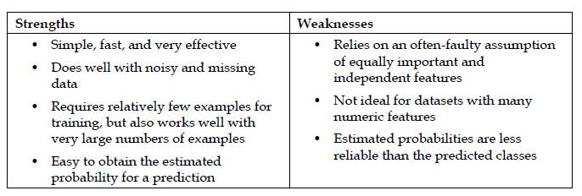
Notes:
Pros and Cons
The Naïve Bayes’ approach is a very popular one, which often works well.
However, it has a number of potential problems
It relies on all attributes being categorical.
If the data is less, then it estimates poorly.

Slide 6

Bayes Theorem
Bayes' theorem is also known as Bayes' Rule or Bayes' law, which is used to determine the probability of a hypothesis with prior knowledge. It depends on the conditional probability.
The formula for Bayes' theorem is given as:

Slide 7
Where,
P(A|B) is Posterior probability: Probability of hypothesis A on the observed event B.
P(B|A) is Likelihood probability: Probability of the evidence given that the probability of a hypothesis is true.
P(A) is Prior Probability: Probability of hypothesis before observing the evidence.
P(B) is Marginal Probability: Probability of Evidence.

Slide 8
Problem Statement
Suppose we have a dataset of weather conditions and corresponding target variable "Play". So using this dataset we need to decide that whether we should play or not on a particular day according to the weather conditions.

Slide 9
 | Outlook | Play
0 | Rainy | Yes
1 | Sunny | Yes
2 | Overcast | Yes
3 | Overcast | Yes
4 | Sunny | No
5 | Rainy | Yes
6 | Sunny | Yes
7 | Overcast | Yes
8 | Rainy | No
9 | Sunny | No
10 | Sunny | Yes
11 | Rainy | No
12 13 | Overcast Overcast | Yes Yes

Slide 10
Weather | No | Yes
Overcast | 0 | 5 | 5/14= 0.35
Rainy | 2 | 2 | 4/14=0.29
Sunny | 2 | 3 | 5/14=0.35
All | 4/14=0.29 | 10/14=0.71
Applying Bayes'theorem:
P(Yes|Sunny)= P(Sunny|Yes)*P(Yes)/P(Sunny)
P(Sunny|Yes)= 3/10= 0.3
P(Sunny)= 0.35
P(Yes)=0.71
So P(Yes|Sunny) = 0.3*0.71/0.35= 0.60
P(No|Sunny)= P(Sunny|No)*P(No)/P(Sunny)
P(Sunny|NO)= 2/4=0.5
P(No)= 0.29
P(Sunny)= 0.35
So P(No|Sunny)= 0.5*0.29/0.35 = 0.41
So as we can see from the above calculation that P(Yes|Sunny)>P(No|Sunny)
Hence on a Sunny day, Player can play the game.

Slide 11
Using numeric features with Naive Bayes
Naive Bayes uses frequency tables to learn the data, each feature must be categorical in order to create the combinations of class and feature values comprising of the matrix.
Since numeric features do not have categories of values, the preceding algorithm does not work directly with numeric data.
One easy and effective solution is to discretize numeric features, which simply means that the numbers are put into categories known as bins.

Slide 12
Discretization is also sometimes called binning.
There are several different ways to discretize a numeric feature. Perhaps the most common is to explore the data for natural categories or cut points in the distribution of data.
For example, suppose that you added a feature to the spam dataset that recorded the time of night or day the e-mail was sent, from 0 to 24 hours past midnight.

Slide 13
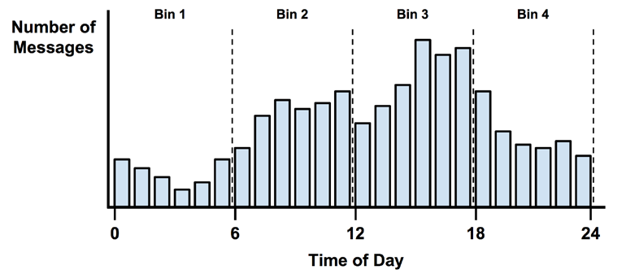

Slide 14
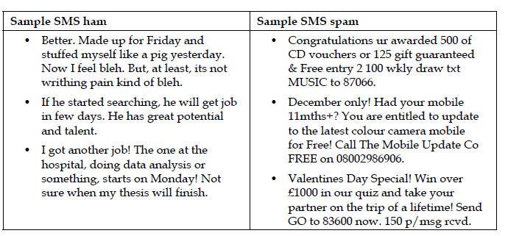

Slide 15
Air-Traffic Data
Days | Season | Fog | Rain | Class
Weekday | Spring | None | None | On Time
Weekday | Winter | None | Slight | On Time
Weekday | Winter | None | None | On Time
Holiday | Winter | High | heavy | Late
Saturday | Summer | Normal | None | On Time
Weekday | Autumn | Normal | None | Very Late
Holiday | Summer | High | Slight | On Time
Sunday | Summer | Normal | None | On Time
Weekday | Winter | High | Heavy | Very Late
Weekday | Summer | None | Slight | On Time
Cond. to next slide…

Slide 16
Air-Traffic Data
Cond. from previous slide…
Days | Season | Fog | Rain | Class
Saturday | Spring | High | Heavy | Cancelled
Weekday | Summer | High | Slight | On Time
Weekday | Winter | Normal | None | Late
Weekday | Summer | High | None | On Time
Weekday | Winter | Normal | Heavy | Very Late
Saturday | Autumn | High | Slight | On Time
Weekday | Autumn | None | Heavy | On Time
Holiday | Spring | Normal | Slight | On Time
Weekday | Spring | Normal | slight | On Time
Weekday | Spring | Normal | slight | On Time
Notes:
P(Y|X) ≈𝑃(𝑋│𝑌)∙𝑃(𝑌)

Slide 17
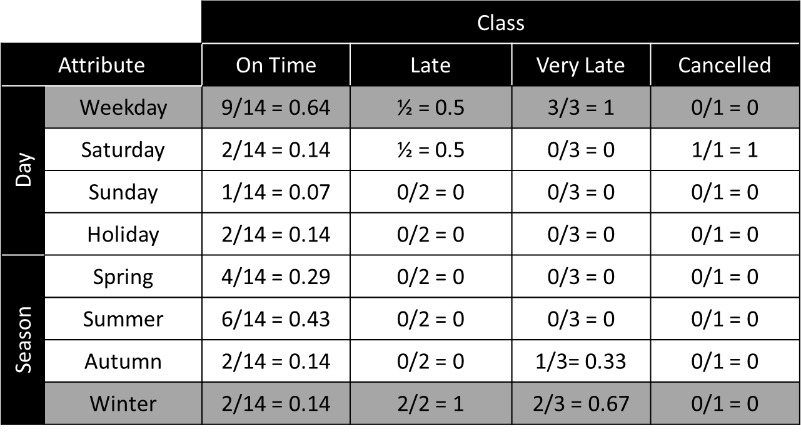
Naïve Bayesian Classifier
Example: With reference to the Air Traffic Dataset mentioned earlier, let us tabulate all the posterior and prior probabilities as shown below.

Slide 18
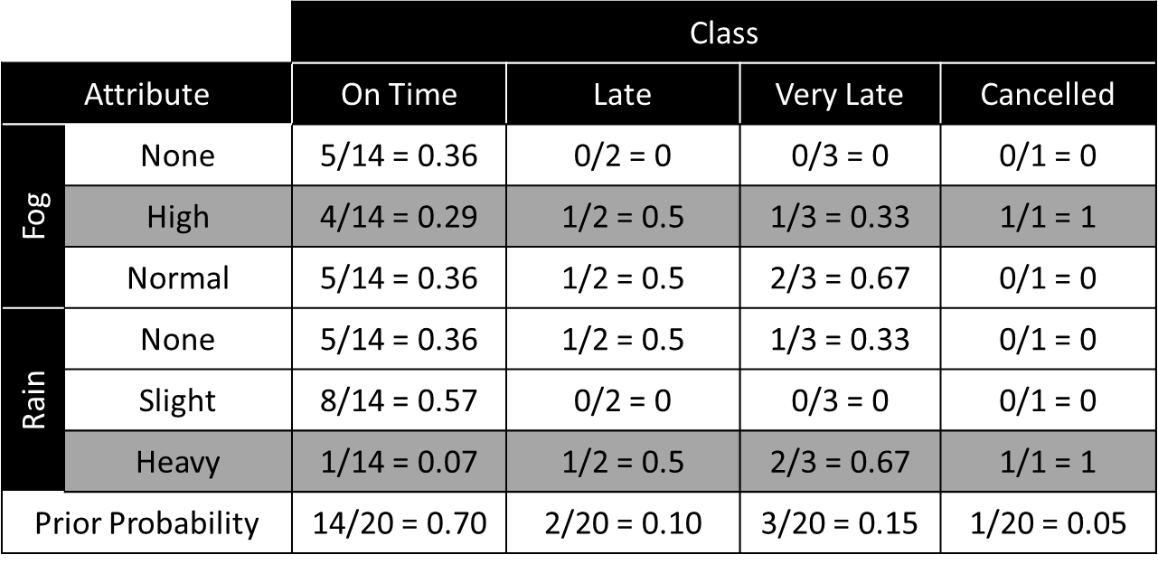
Naïve Bayesian Classifier

Slide 19
Naïve Bayesian Classifier
Instance:
Case1: Class = On Time : 0.70 × 0.64 × 0.14 × 0.29 × 0.07 = 0.0013
Case2: Class = Late : 0.10 × 0.50 × 1.0 × 0.50 × 0.50 = 0.0125
Case3: Class = Very Late : 0.15 × 1.0 × 0.67 × 0.33 × 0.67 = 0.0222
Case4: Class = Cancelled : 0.05 × 0.0 × 0.0 × 1.0 × 1.0 = 0.0000
Case3 is the strongest; Hence correct classification is Very Late
Week Day | Winter | High | Heavy | ???

Slide 20
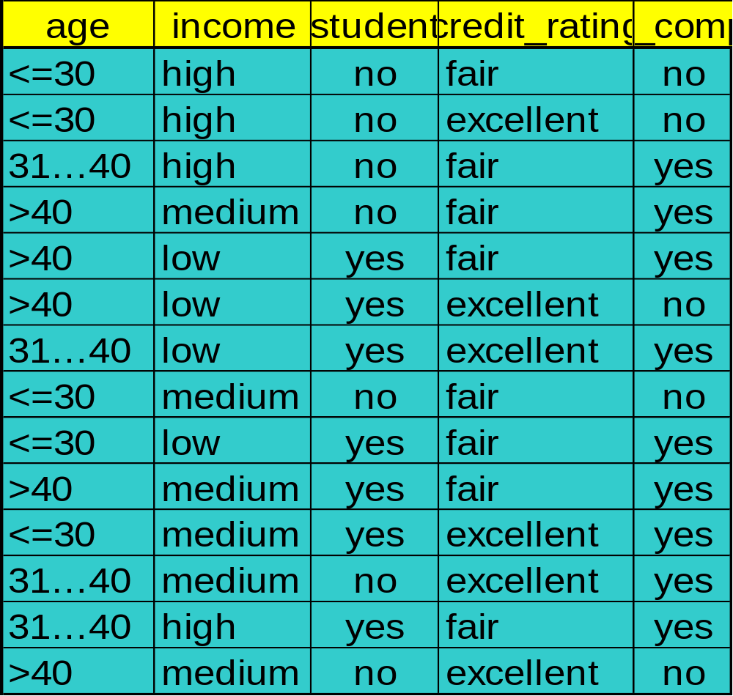
A Practice Example
Example 8.4
Class:
C1:buys_computer = ‘yes’
C2:buys_computer = ‘no’
Data instance
X = (age <=30,
Income = medium,
Student = yes
Credit_rating = fair)

Slide 21
A Practice Example
P(C_{i}): P(buys_computer = “yes”) = 9/14 = 0.643
P(buys_computer = “no”) = 5/14= 0.357
Compute P(X|C_{i}) for each class
P(age = “<=30” | buys_computer = “yes”) = 2/9 = 0.222
P(age = “<= 30” | buys_computer = “no”) = 3/5 = 0.6
P(income = “medium” | buys_computer = “yes”) = 4/9 = 0.444
P(income = “medium” | buys_computer = “no”) = 2/5 = 0.4
P(student = “yes” | buys_computer = “yes) = 6/9 = 0.667
P(student = “yes” | buys_computer = “no”) = 1/5 = 0.2
P(credit_rating = “fair” | buys_computer = “yes”) = 6/9 = 0.667
P(credit_rating = “fair” | buys_computer = “no”) = 2/5 = 0.4
X = (age <= 30 , income = medium, student = yes, credit_rating = fair)
P(X|C_{i}) : P(X|buys_computer = “yes”) = 0.222 × 0.444 × 0.667 × 0.667 = 0.044
P(X|buys_computer = “no”) = 0.6 × 0.4 × 0.2 × 0.4 = 0.019
P(X|C_{i})*P(C_{i}) : P(X|buys_computer = “yes”) * P(buys_computer = “yes”) = 0.028
P(X|buys_computer = “no”) * P(buys_computer = “no”) = 0.007
Therefore, X belongs to class (“buys_computer = yes”)

Slide 22
Filtering mobile phone spam with the Naive Bayes algorithm
As the worldwide use of mobile phones has grown, a new avenue for electronic junk mail has opened for disreputable marketers.
To develop the Naive Bayes classifier, we will use data adapted from the SMS Spam Collection.
This dataset includes the text of SMS messages along with a label indicating whether the message is unwanted. Junk messages are labeled spam, while legitimate messages are labeled ham.

Slide 23
We'll begin by importing the CSV data and saving it in a data frame:
> sms_raw <- read.csv("sms_spam.csv", stringsAsFactors = FALSE)
Using the str() function, we see that the sms_raw data frame includes 5,559 total SMS messages with two features: type and text.
> str(sms_raw)

Slide 24
The type element is currently a character vector. Since this is a categorical variable, it would be better to convert it into a factor, as shown in the following code:
> sms_raw$type <- factor(sms_raw$type)
Examining this with the str() and table() functions, we see that type has now been appropriately recoded as a factor. Additionally, we see that 747 (about 13 percent) of SMS messages in our data were labeled as spam, while the others were labeled as ham:

Slide 25
SMS messages are strings of text composed of words, spaces, numbers, and punctuation.
Handling this type of complex data takes a lot of thought and effort.
This functionality has been provided by the members of the R community in a text mining package titled tm.
> install.packages("tm")

Slide 26
> library(tm)
The first step in processing text data involves creating a corpus, which is a collection of text documents.
Since we already loaded the SMS message text into R, we'll use the VectorSource() reader function to create a source object from the existing sms_raw$text vector, which can then be supplied to VCorpus() as follows:
sms_corpus <-VCorpus(VectorSource(sms_raw$text))

Slide 27
By printing the corpus, we see that it contains documents for each of the 5,559 SMS messages in the training data:
> print(sms_corpus)
To view the actual message text, the as.character() function must be applied to the desired messages.
> as.character(sms_corpus[[1]])

Slide 28
To view multiple documents, we'll need to use as.character() on several items in the sms_corpus object. To do so, we'll use the lapply() function.
> lapply(sms_corpus[1:2], as.character)
the corpus contains the raw text of 5,559 text messages. In order to perform our analysis, we need to divide these messages into individual words.

Slide 29
The tm_map() function provides a method to apply a transformation (also known as mapping) to a tm corpus.
Our first order of business will be to standardize the messages to use only lowercase characters.
We need to use the tm wrapper function content_transformer() to treat tolower() as a
transformation function that can be used to access the corpus.

Slide 30
> sms_corpus_clean <- tm_map(sms_corpus,
content_transformer(tolower))
Let's inspect the first message in the original corpus and compare it to the same in the transformed corpus:
> as.character(sms_corpus[[1]])
> as.character(sms_corpus_clean[[1]])
Let's continue our cleanup by removing numbers from the SMS messages.

Slide 31
sms_corpus_clean<- tm_map(sms_corpus_clean, removeNumbers)
Our next task is to remove filler words such as to, and, but, and or from our SMS messages. These terms are known as stop words.
The stop words alone are not a useful transformation. What we need is a way to remove any words that appear in the stop words list. The solution lies in the removeWords() function

Slide 32
> sms_corpus_clean <- tm_map(sms_corpus_clean,
removeWords, stopwords())
We can also eliminate any punctuation from the text messages using the built-in removePunctuation() transformation:
> sms_corpus_clean <- tm_map(sms_corpus_clean, removePunctuation)

Slide 33
Another common standardization for text data involves reducing words to their root form in a process called stemming.
The tm package provides stemming functionality via integration with the SnowballC package.
> install.packages("SnowballC")
> library(SnowballC)

Slide 34
The SnowballC package provides a wordStem() function, which for a character vector, returns the same vector of terms in its root form.
In order to apply the wordStem() function to an entire corpus of text documents, the tm package includes a stemDocument() transformation.
We apply this to our corpus with the tm_map() function exactly as done earlier

Slide 35
> sms_corpus_clean <- tm_map(sms_corpus_clean, stemDocument)
The final step in our text cleanup process is to remove additional whitespace, using the built-in stripWhitespace() transformation:
> sms_corpus_clean <- tm_map(sms_corpus_clean, stripWhitespace)

Slide 36
The final step is to split the messages into individual components through a process called tokenization.
The DocumentTermMatrix() function will take a corpus and create a data structure called a Document Term Matrix (DTM) in which rows indicate documents (SMS messages) and columns indicate terms (words).
>sms_dtm<- DocumentTermMatrix(sms_corpus_clean)

Slide 37
With our data prepared for analysis, we now need to split the data into training and test datasets, so that once our spam classifier is built, it can be evaluated on data it has not previously seen.
We'll divide the data into two portions: 75 percent for training and 25 percent for testing.
We can simply take the first 4,169 for training and leave the remaining 1,390 for testing.

Slide 38
> sms_dtm_train <- sms_dtm[1:4169, ]
> sms_dtm_test <- sms_dtm[4170:5559, ]
The labels are not stored in the DTM, so we would need to pull them from the original sms_raw data frame:
> sms_train_labels <- sms_raw[1:4169, ]$type
> sms_test_labels <- sms_raw[4170:5559, ]$type

Slide 39
Let's compare the proportion of spam in the training and test data frames:
> prop.table(table(sms_train_labels))
> prop.table(table(sms_test_labels))
A word cloud is a way to visually depict the frequency at which words appear in text data.
Words appearing more often in the text are shown in a larger font, while less common terms are shown in smaller fonts.

Slide 40
The wordcloud package provides a simple R function to create this type of diagrams.
> install.packages("wordcloud")
> library(wordcloud)
This will create a word cloud from our prepared SMS corpus. Since we specified random.order = FALSE, the cloud will be arranged in a nonrandom order with higher frequency words placed closer to the center
> wordcloud(sms_corpus_clean, min.freq = 50, random.order = FALSE)

Slide 41
The min.freq parameter specifies the number of times a word must appear in the corpus before it will be displayed in the cloud.
The final step in the data preparation process is to transform the sparse matrix into a data structure that can be used to train a Naive Bayes classifier.
To reduce the number of features, we will eliminate any word that appear in less than five SMS messages, or in less than about 0.1 percent of the records in the training data.

Slide 42
Finding frequent words requires use of the findFreqTerms() function in the tm package.
> sms_freq_words <- findFreqTerms(sms_dtm_train, 5)
> str(sms_freq_words)
We now need to filter our DTM to include only the terms appearing in a specified vector.
we want all the rows, but only the columns representing the words in the sms_freq_words vector, our commands are:

Slide 43
> sms_dtm_freq_train<- sms_dtm_train[ , sms_freq_words]
> sms_dtm_freq_test <- sms_dtm_test[ , sms_freq_words]
The Naive Bayes classifier is typically trained on data with categorical features.
The following defines a convert_counts() function to convert counts to Yes/No strings:

Slide 44
> convert_counts <- function(x) {
x <- ifelse(x > 0, "Yes", "No")
}
We now need to apply convert_counts() to each of the columns in our sparse matrix.
The apply() function allows a function to be used on each of the rows or columns in a matrix. It uses a MARGIN parameter to specify either rows or columns.

Slide 45
> sms_train <- apply(sms_dtm_freq_train, MARGIN = 2, convert_counts)
> sms_test <- apply(sms_dtm_freq_test, MARGIN = 2, convert_counts)
It is time to apply the Naive Bayes algorithm.
The algorithm will use the presence or absence of words to estimate the probability that a given SMS message is spam.

Slide 46
The Naive Bayes implementation we will employ is in the e1071 package.
> install.packages("e1071")
> library(e1071)
To build our model on the sms_train matrix, we'll use the following command:
> sms_classifier <- naiveBayes(sms_train, sms_train_labels)

Slide 47
To evaluate the SMS classifier, we need to test its predictions on unseen messages in the test data.
The classifier that we trained has been named sms_classifier.
The predict() function is used to make the predictions.
> sms_test_pred <- predict(sms_classifier, sms_test)

Slide 48
To compare the predictions to the true values, we'll use the CrossTable() function in the gmodels package.
> library(gmodels)
> CrossTable(sms_test_pred,sms_test_labels,
prop.chisq = FALSE, prop.t = FALSE, dnn = c('predicted', 'actual'))

